Slide 1


2018 Checklist Procedures
Common Development GAR100003

Slide 2
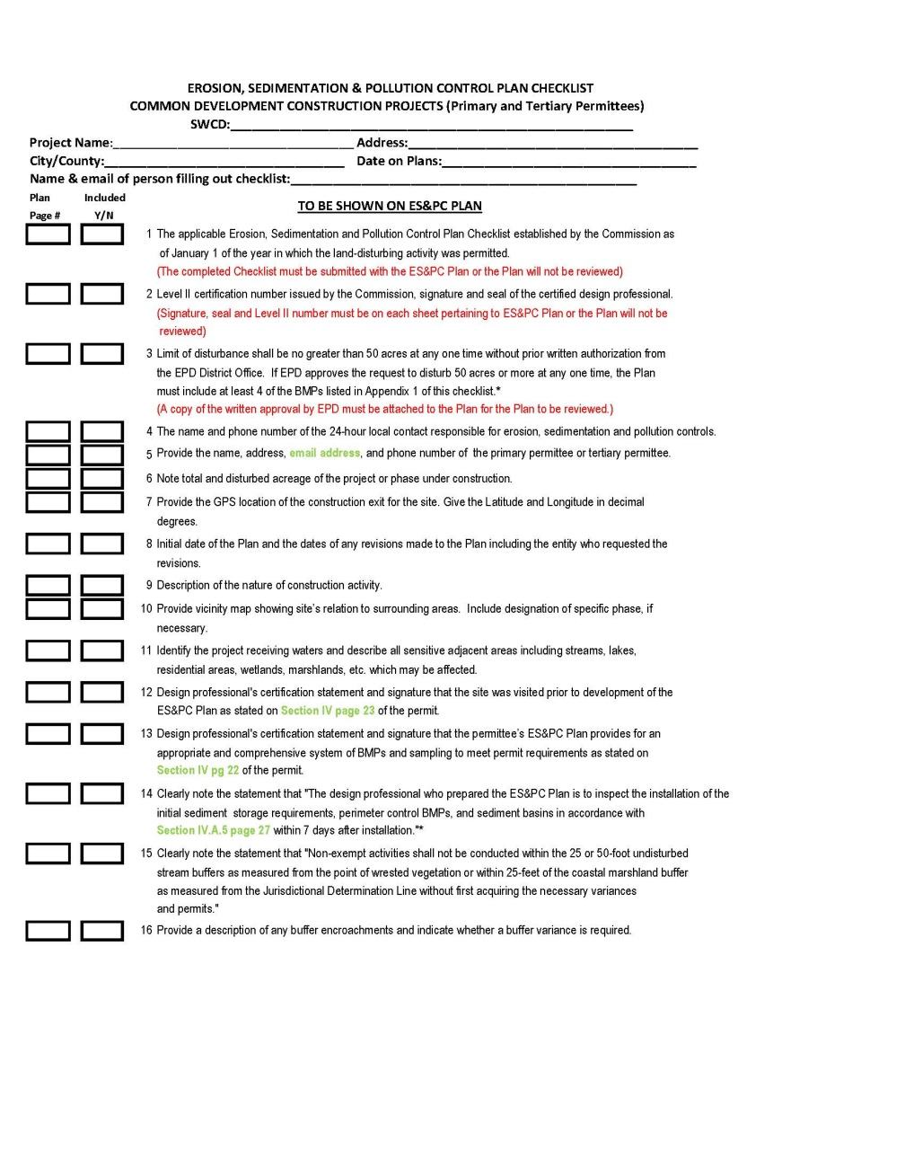
Checklist Item #1
2
The applicable Erosion, Sedimentation, and Pollution Control Plan Checklist established by the Commission as of January 1 of the year in which the land-disturbing activity was permitted.
NPDES Construction Stormwater General permits were revised May 2018 and will become effective August 1, 2018
The completed Checklist must be submitted with the ES&PC Plan or the Plan will not be reviewed.

Slide 3

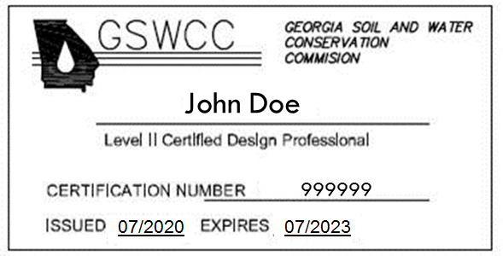
Checklist Item #2
3
Level II certification number issued by the Commission, signature, and seal of the certified design professional.
Signature, seal, and Level II number must be on each sheet pertaining to ES&PC Plan or the Plan will not be reviewed. The Level II certification must be issued to the Design Professional whose signature and seal are on the Plan.

Slide 4
Checklist Item #3
4
Limit of disturbance shall be no greater than 50 acres at any one time without prior written authorization from the EPD District Office. If EPD approves the request to disturb 50 acres or more at any one time, the Plan must include at least 4 of the BMPs listed in Appendix 1 of this checklist.
A copy of the written approval by EPD must be attached to the Plan for the Plan to be reviewed.

Slide 5
Checklist Item #4
5
The name and phone number of the 24-hour local contact responsible for erosion, sedimentation, and pollution controls.
May be shown on ES&PC Plan sheets and/or ES&PC notes.
24 Hour Contact:
John Doe
555-555-5555

Slide 6
Checklist Item #5
6
Provide the name, address, email address, and phone number of primary permittee or tertiary permittee.
May be shown on cover sheet, ES&PC Plan, or under ES&PC notes.
Primary Permittee/Tertiary Permittee:
(Company/Person)
(Address)
(Contact)
(Email Address)
(Phone)

Slide 7

Checklist Item #6
7
Note total and disturbed acreage of the project or phase under construction.
Must be shown on ES&PC Plan or under ES&PC notes.

Slide 8
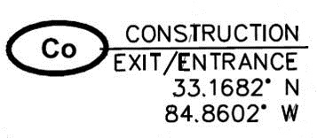
Checklist Item #7
8
Provide the GPS location of the Construction Exit for the site. Give the Latitude and Longitude in decimal degrees.
GPS location of the Construction Exit must be shown on cover sheet and may also be shown on ES&PC Plan sheets and ES&PC notes. It must match the NOI.

Slide 9
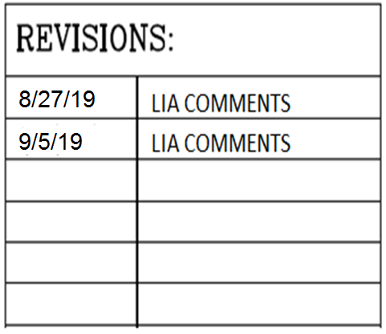

Checklist Item #8
9
Initial date of the Plan and the dates of any revisions made to the Plan including the entity who requested the revisions.
The initial Plan date should be shown on all pages. With each resubmittal the revision date and the entity requesting revisions should be shown on cover sheet and each sheet that has been revised.

Slide 10
Checklist Item #9
10
Description of the nature of construction activity.
Provide a description of the existing site and a description of the proposed project. These must be shown on ES&PC Plan or under ES&PC notes.
The site is currently developed and has one structure on the property. The proposed construction consists of an access drive and grading for a future expansion. The proposed construction will also include landscaping, and a stormwater conveyance system.

Slide 11
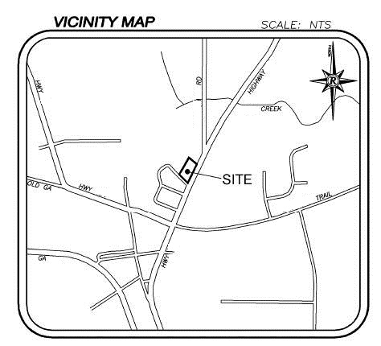
Checklist Item #10
11
Provide vicinity map showing site’s relation to surrounding areas. Include designation of specific phase, if necessary.
Site location must be delineated showing surrounding area roads and highways. If the project is being done in phases, each individual phase must be delineated and labeled. This information is important for Plan reviewers if a site visit is needed, or if the site needs to be located on another map.

Slide 12
Checklist Item #11
12
Identify the project receiving waters and describe all sensitive adjacent areas including streams, lakes, residential areas, wetlands, etc. which may be affected.
The name of the initial receiving water(s) or if unnamed the first named blue line stream indicated on the appropriate USGS topographic map, and when the discharge is through a municipal separate storm sewer system (MS4), the name of the local government operating the municipal separate storm sewer system and the name of the receiving water(s) which receives the discharge from the MS4, and the permittee’s determination of the whether the receiving water(s) supports warm water fisheries or is a trout stream. Describe any neighboring area which could be affected by the post-developed runoff from the site.

Slide 13
Checklist Item #12
13
Design professional’s certification statement and signature that the site was visited prior to development of the ES&PC Plan as stated on page 23 of the permit.
The following statement and the signature of the design professional must be shown on the ES&PC Plan or under ES&PC notes:
    “I certify under penalty of law that this Plan was prepared after a site visit to the locations described herein by myself or my authorized agent, under my supervision.”

Slide 14
Checklist Item #13
14
Design professional’s certification statement and signature that the permittee’s ES&PC Plan provides for an appropriate and comprehensive system of BMPs and sampling to meet permit requirements as stated on page 22 of the permit.
The following statement and the signature of the design professional must be shown on the ES&PC Plan or under ES&PC notes:
    “I certify that the permittee’s Erosion, Sedimentation, and Pollution Control Plan provides for an appropriate and comprehensive system of best management practices required by the Georgia Water Quality Control Act and the document “Manual for Erosion and Sediment Control in Georgia” (Manual) published by the State Soil and Water Conservation Commission as of January 1 of the year in which the land-disturbing activity was permitted, provides for the sampling of the receiving water(s) or the sampling of the storm water outfalls and that the designed system of best management practices and sampling methods is expected to meet the requirements contained in the General NPDES Permit No. GAR100003.”

Slide 15
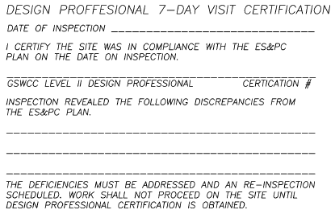
Checklist Item #14
15
Clearly note the statement that “The design professional who prepared the ES&PC Plan is to inspect the installation of the initial sediment storage requirements and perimeter control BMPs within 7 days after installation.”
The Plan must include a statement indicating that the primary permittee must retain the design professional who prepared the Plan, except when the primary permittee has requested in writing and EPD has agreed to an alternate design professional, to inspect the installation of the initial sediment storage requirements and perimeter control BMPs which the design professional designed within seven (7) days after installation. The design professional shall determine if these BMPs have been installed and are being maintained as designed. The design professional shall report the results of the inspection to the primary permittee within seven (7) days and the permittee must correct all deficiencies with two (2) business days of receipt of the inspection report from the design professional unless weather related site conditions are such that additional time is required.

Slide 16
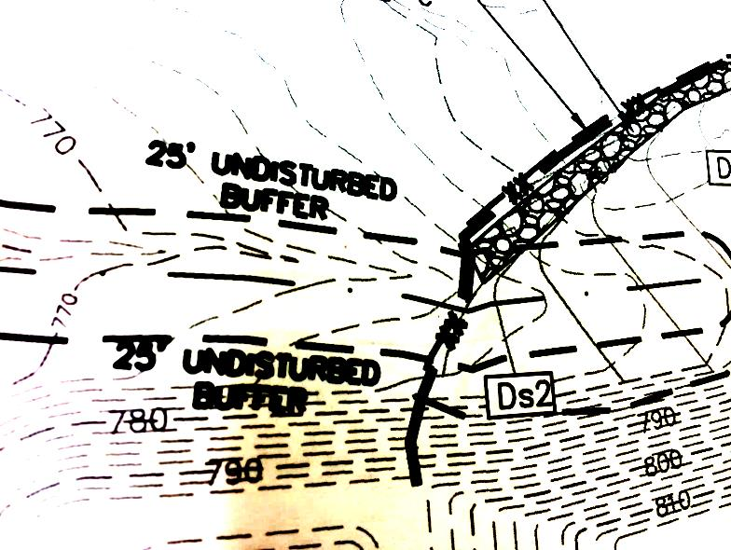
Checklist Item #15
16
Clearly note the statement that “Non-exempt activities shall not be conducted within the 25 or 50-foot undisturbed stream buffers as measured from the point of wrested vegetation or within 25-feet of the coastal marshland-upland interface without first acquiring the necessary variances and permits.”
See Part IV. (i) - (iv) on pages 23-26 of the permit and show under ES&PC notes.

Slide 17
Checklist Item #16
17
Provide a description of any buffer encroachments and indicate whether a buffer variance is required.
When the project requires an approved buffer variance from the GA EPD, an indication shall be shown on the ES&PC Plan. A description of the encroachment activity must be shown on the ES&PC Plan or under ES&PC notes.

Slide 18
Checklist Item #17
18
Clearly note the statement that “Amendments/revisions to the ES&PC Plan which have a significant effect on BMPs with a hydraulic component must be certified by the design professional.”
See Part IV. C. on page 29 of the permit. This can be clarified in a narrative and shown under ES&PC notes. Revisions or amendments should be submitted to the Local Issuing Authority for review.

Slide 19
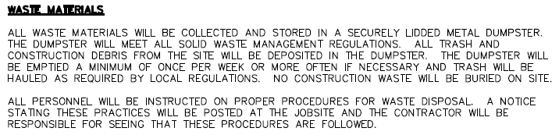
Checklist Item #18
19
Clearly note the statement that “Waste materials shall not be discharged to waters of the State, except as authorized by a section 404 permit.”
The Plan must include a description of how waste materials, including waste building materials, construction and demolition debris, concrete washout, excavated sediment, etc., will be properly disposed of. Any disposal of solid waste to waters of the State is prohibited unless authorized by a Section 404 permit.

Slide 20
Checklist Item #19
20
Clearly note the statement that “The escape of sediment from the site shall be prevented by the installation of erosion and sediment control measures and practices prior to land disturbing activities.”
Must be shown on ES&PC Plan or under ES&PC notes.

Slide 21
Checklist Item #20
21
Clearly note the statement that “Erosion control measures will be maintained at all times. If full implementation of the approved Plan does not provide for effective erosion control, additional erosion and sediment control measures shall be implemented to control or treat the sediment source.”
Must be shown on ES&PC Plan or under ES&PC notes.

Slide 22
Checklist Item #21
22
Clearly note the statement that “Any disturbed area left exposed for a period greater than 14 days shall be stabilized with mulch or temporary seeding.”
Must be shown on ES&PC Plan or under ES&PC notes.

Slide 23
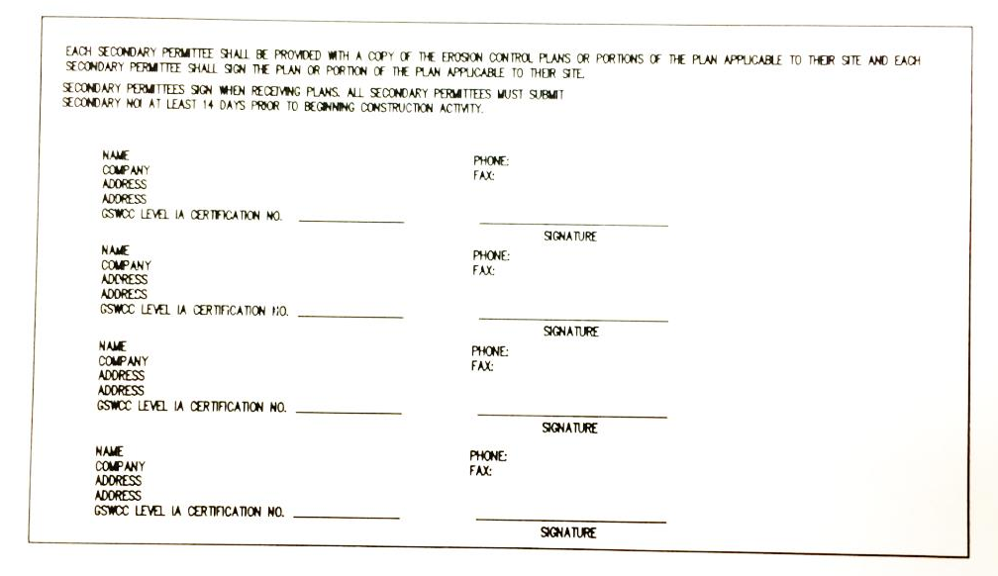
Checklist Item #22
23
Indication that the applicable portion of the primary permittees ES&PC Plan is to be provided to each secondary permittee prior to the secondary conducting any construction activity and that each secondary shall sign the Plan or portion of the Plan applicable to their site. List the names and addresses of all secondary permittees.
The Plan must contain a list and contact information for all secondary permittees and a statement that the primary permittee shall provide a copy of the Plan (and any subsequent revisions to the Plan) to each secondary permittee. The Plan must include a section for each secondary to sign indicating that they have made a written acknowledgement of receipt of the Plan and a copy of the acknowledgement must be kept in the primary’s records.

Slide 24
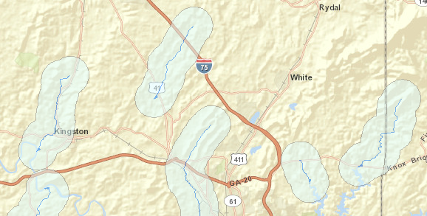
Checklist Item #23
24
Any construction activity which discharges storm water into an Impaired Stream Segment, or within 1 linear mile upstream of and within the same watershed as, any portion of an Biota Impaired Stream Segment must comply with Part III. C. of the permit. Include the completed Appendix 1 listing all the BMPs that will be used for those areas of the site which discharge to the Impaired Stream Segment.
If any storm water associated with construction activities discharges into an Impaired Stream Segment that has been listed for the criteria violated, “Bio F” (Impaired Fish Community) and/or “Bio M” (Impaired Macroinvertebrate Community), within Category 4a, 4b or 5, and the potential cause is either “NP” (nonpoint source) or “UR” (urban runoff), the ES&PC Plan must include at least four (4) of the BMPs listed in Part III.C.2. (a)-(v) of the permit. The Impaired Stream Segment(s) should be delineated on the ES&PC Plan. Georgia’s most current and subsequent “305(b)/303(d) List Documents (Approved) can be viewed on the GAEPD website.

Slide 25
Checklist Item #24
25
If a TMDL Implementation Plan for sediment has been finalized for the Impaired Stream Segment (identified in Item 23 above) at least six months prior to submittal of NOI, the ES&PC Plan must address any site-specific conditions or requirements included in the TMDL Implementation Plan.
List of TMDL Implementation Plans can be viewed on the GAEPD website, www.gaepd.org
The TMDL Implementation Plan for sediment should be delineated on the ES&PC Plan.

Slide 26
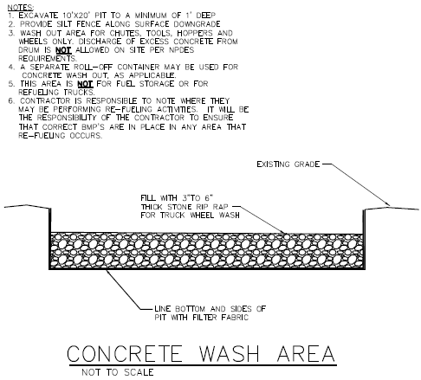
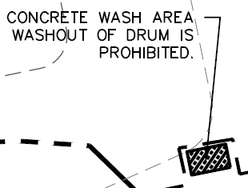
Checklist Item #25
26
BMPs for concrete wash-down of tools, concrete mixer chutes, hoppers, and the rear of the vehicles. Washout of the drum at the construction site is prohibited.
When the project allows for the concrete wash-down of tools, concrete mixer chutes, hoppers, and the rear of the vehicles on the project site delineate the location of the area provided for washing and provide detail of BMPs that will be used. If the project does not allow for the concrete wash-down on the project site, note that on the Plan.

Slide 27
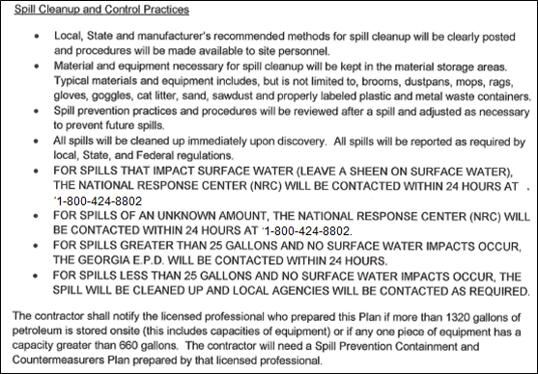
Checklist Item #26
27
Provide BMPs for the remediation of all petroleum spills and leaks.
The Plan must provide BMPs and guidance for the prevention of spills and leaks of petroleum products from any areas where such products are stored or used as well as guidance for the proper remediation of any spills and leaks that do occur. This information can be in the form of a separate Spill Prevention/Spill Response document so long as that information accompanies the Plan.

Slide 28
Checklist Item #27 (New)
28
Description of practices to provide cover for building materials and building products on site.
The Plan must contain a description of measures, such as plastic sheeting or temporary roofs, to cover building materials, building products, construction wastes, trash, landscape materials, fertilizers, pesticides, herbicides, detergents, sanitary waste, and other materials in order to minimize exposure to precipitation and to stormwater.

Slide 29
Checklist Item #28
29
Description of the measures that will be installed during the construction process to control pollutants in storm water that will occur after construction operations have been completed.
The Plan must contain a description of the measures that will be installed during the construction process to control pollutants in storm water that will occur after construction operations have been completed. These may include storm water detention and retention structures, use of vegetated swales and natural depressions for flow attenuation or a combination of these practices (sequential systems). The Plan must also include a technical explanation of the basis used to select these practices where flows will exceed pre-development levels. The Plan must indicate that velocity dissipation devices will be placed at discharge locations and along the length of any outflow channel in order to provide a non-erosive flow so that the natural physical and biological characteristics and functions of the water course are maintained and protected. The installation of these devices may be subject to Section 404 of the Federal Clean Water Act.
Note: The permittee is only responsible for the installation and maintenance of storm water management devices prior to final stabilization of the site and not the operation and maintenance of such structures after construction activities have been completed.

Slide 30
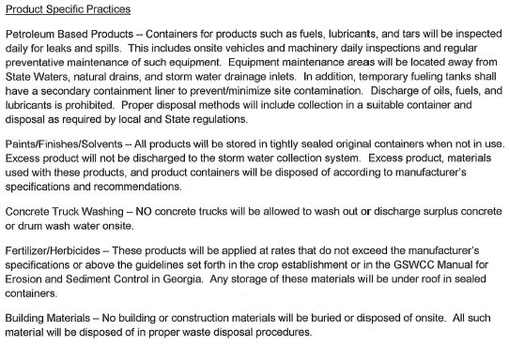
Checklist Item #29
30
Description of the practices that will be used to reduce the pollutants in storm water discharges.
The Plan must identify all potential sources of storm water pollution expected to be present on the site and provide a narrative explaining how the pollutants will be minimized in the storm water discharges.

Slide 31
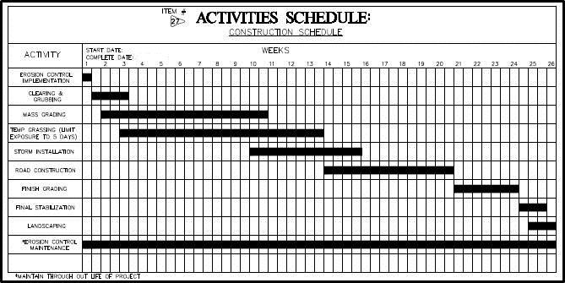
Checklist Item #30
31
Description and chart or timeline of the intended sequence of major activities which disturb soils for the major portions of the site (i.e. initial perimeter and sediment storage BMPs, clearing and grubbing activities, excavation activities, utility activities, temporary and final stabilization).
Activity schedule must be site specific. The narrative description and timeline for each phase of construction may be shown on ES&PC Plan sheet or under ES&PC notes.

Slide 32
Checklist Item #31
32
Provide complete requirements of Inspections and record keeping by the primary permittee or tertiary permittee.
The Plan must include all of the Inspections and record keeping requirements of the primary permittee as stated in Part IV.D.4.a. – c. on pages 34-40 of the permit. The complete Inspection and record keeping requirements shall be shown on the Plan under ES&PC notes.

Slide 33
New wording in 2018 Permits

Slide 34
Checklist Item #32
34
Provide complete requirements of Sampling Frequency and Reporting of sampling results.
See Section IV.D.6.d on pages 43-44 Sampling Frequency and Section IV.E page 44-45 Reporting in the permit. Complete sampling frequency and reporting requirements are to be shown on the Plan under ES&PC notes.

Slide 35
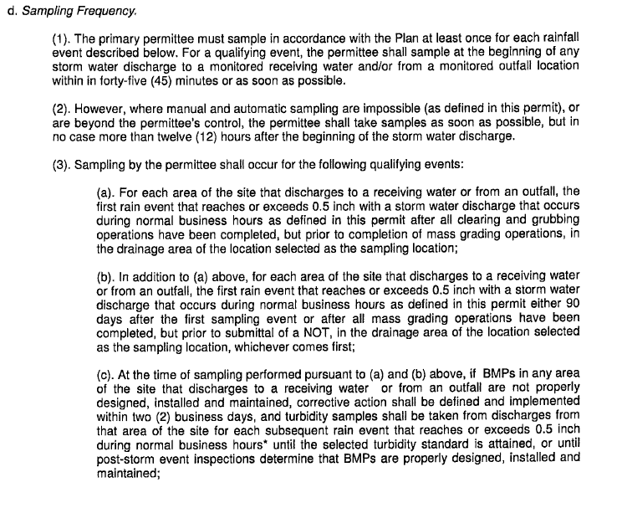
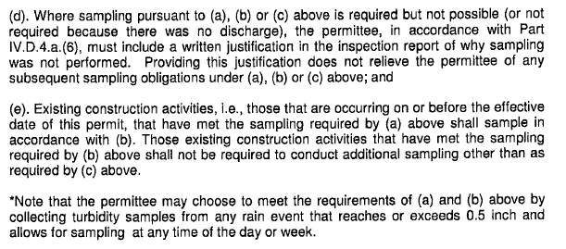
New wording in 2018 Permits

Slide 36
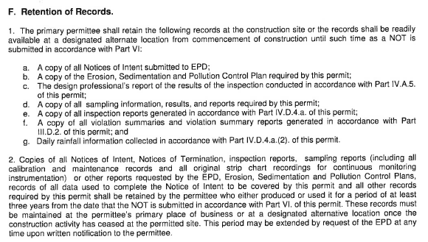
Checklist Item #33
36
Provide complete details for Retention of Records as per Section IV.F of the permit.
See Section IV.F page 45 Retention of Records in the permit. Complete details of Retention of Records are to be shown on the Plan under ES&PC notes.

Slide 37
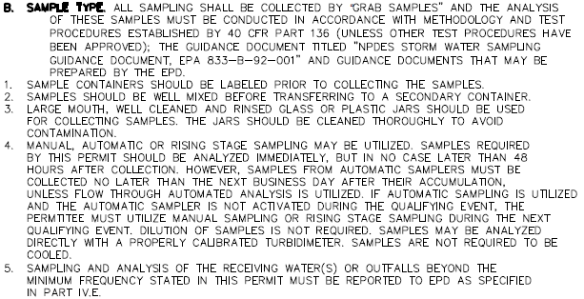
Checklist Item #34
37
Description of analytical methods to be used to collect and analyze the samples from each location.
This narrative must is to be shown on the Plan under ES&PC notes and shall include quality control/assurance procedures and precise sampling methodology for each sampling location.

Slide 38
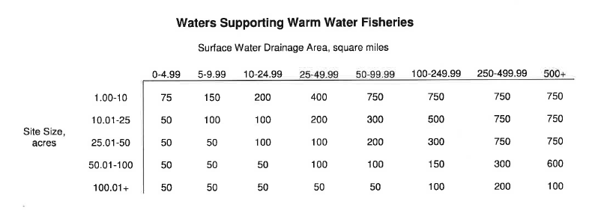
Checklist Item #35
38
Appendix B rationale for NTU values at all outfall sampling points where applicable.
When the permittee has determined that some or all outfalls will be monitored, a rationale must be shown on the Plan under ES&PC notes which includes the NTU limit(s) selected from Appendix B. This rationale must include the size of the construction site, the calculation of the size of the surface water drainage area, and the type of receiving water(s) (i.e. trout stream or supporting warm water fisheries).

Slide 39

Checklist Item #36
39
Delineate all sampling locations, perennial and intermittent streams and other water bodies into which storm water is discharged.
The Plan shall include a USGS topographic map, a topographic map or a drawing (referred to as a topographic map) that is a scale equal to or more detailed than a 1:24000 map showing the locations of the site or the common development. The map must include (a) the location of all perennial and intermittent streams and other water bodies as shown on a USGS topographic map, and all other perennial and intermittent streams and other water bodies located during the mandatory field verification, into which the storm water is discharged and (b) the receiving water and/or outfall sampling locations. When the permittee has chosen to use a USGS topographic map and the receiving water(s) is not shown on the USGS topographic map, the location of the receiving water(s) must be hand-drawn on the USGS topographic map from where the storm water(s) enters the receiving water(s) to the point where the receiving water(s) combines with the first blue line stream shown on the USS topographic map.

Slide 40
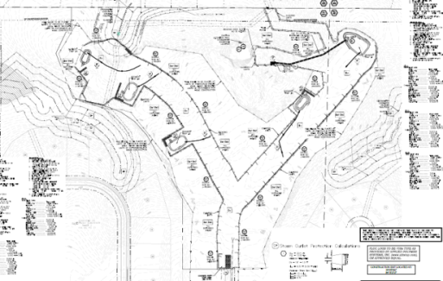
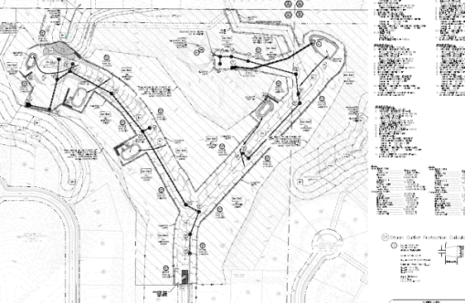
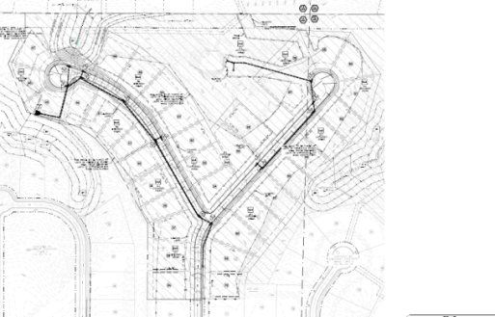
Checklist Item #37
40
A description of appropriate controls and measures that will be implemented at the construction site including: (1) initial sediment storage requirements and perimeter control BMPs (2) intermediate grading and drainage BMPs and (3) final BMPs. For construction sites where there will be no mass grading and the initial perimeter control BMPs, intermediate grading and drainage BMPs, and final BMPs are the same, the Plan may combine all of the BMPs into a single phase.
The Plan must be shown in a minimum of three phases with each phase shown on a separate sheet. Initial phase of the Plan must include the required 67 cy per acre sediment storage, construction exit, tree-save fence if applicable and any other BMPs necessary to prevent sediment from leaving the site such as silt fence, inlet protection on existing storm drain structures, diversions, check dams, temporary ground cover, etc. Limits of disturbance for the initial phase are to be only the areas needed to install initial BMPs. The intermediate phase should show rough grading and utility construction. BMPs should include initial protection, additional silt fence as needed, any revised sediment storage needed as drainage basins are altered, outlet protection, retrofit if applicable, matting with temporary or permanent vegetation as needed, temporary down drains, filter rings, etc. Final phase of Plan should show finished grade, curbing and paving if applicable, building construction if applicable, etc. BMPs should include permanent vegetation, appropriate inlet protection, etc. For construction sites where there will be no mass grading and the initial perimeter control BMPs, intermediate grading and drainage BMPs, and the final BMPs are the same, the Plan may combine all of the BMPs into a single phase Plan. The Plan will include appropriate staging and access requirements for construction equipment.
Initial Phase
Intermediate Phase
Final Phase

Slide 41
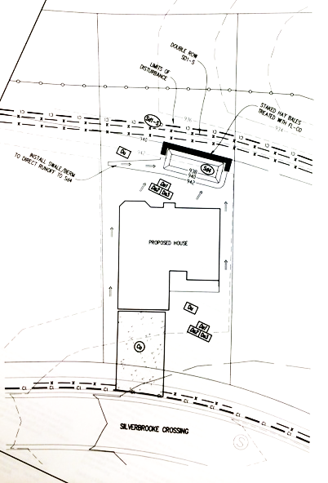
Checklist Item #38
41
Plan addresses BMPs for all phases of common development including individual building lots and out-parcels, etc. regardless of who owns or operates the individual sites. Include a typical and any situational lots applicable.
The Erosion, Sedimentation, & Pollution Control Plans for a common development is designed for the life of the project and must include practices to be implemented by all secondary permittees involved, whether the primary permittee relinquishes ownership of the land rights or not. This includes providing an ES&PC Plan for typical and situational lots for each secondary permittee (builder) who purchases a lot from the primary permittee (developer). Situational lots may include, but are not limited to, lots adjacent to state waters buffers (in which a double row of Type S sediment barriers must be shown adjacent to wetlands, lots with an extreme grade, etc.

Slide 42

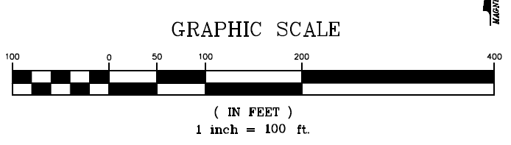
Checklist Item #39
42
Graphic Scale & North Arrow
The graphic scale and north arrow must be clearly shown on all phases of the ES&PC Plan sheets.

Slide 43
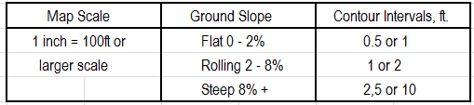
Checklist Item #40
43
Existing and proposed contour lines with contour lines drawn at an interval in accordance with the following:
The initial, intermediate, and final phase sheets of the Plan must show the proposed grade in bold contour lines with the above intervals overlaying the original contour lines. Elevations of both the existing and proposed contour lines must be shown.

Slide 44
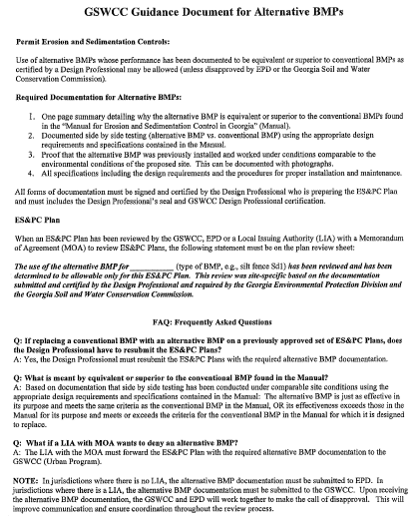
Checklist Item #41
44
Use of alternative BMPs whose performance has been documented to be equivalent to or superior to conventional BMPs as certified by a Design Professional (unless disapproved by EPD or the GSWCC).
Please refer to the Alternative BMP Guidance Document found at www.gaswcc.org

Slide 45
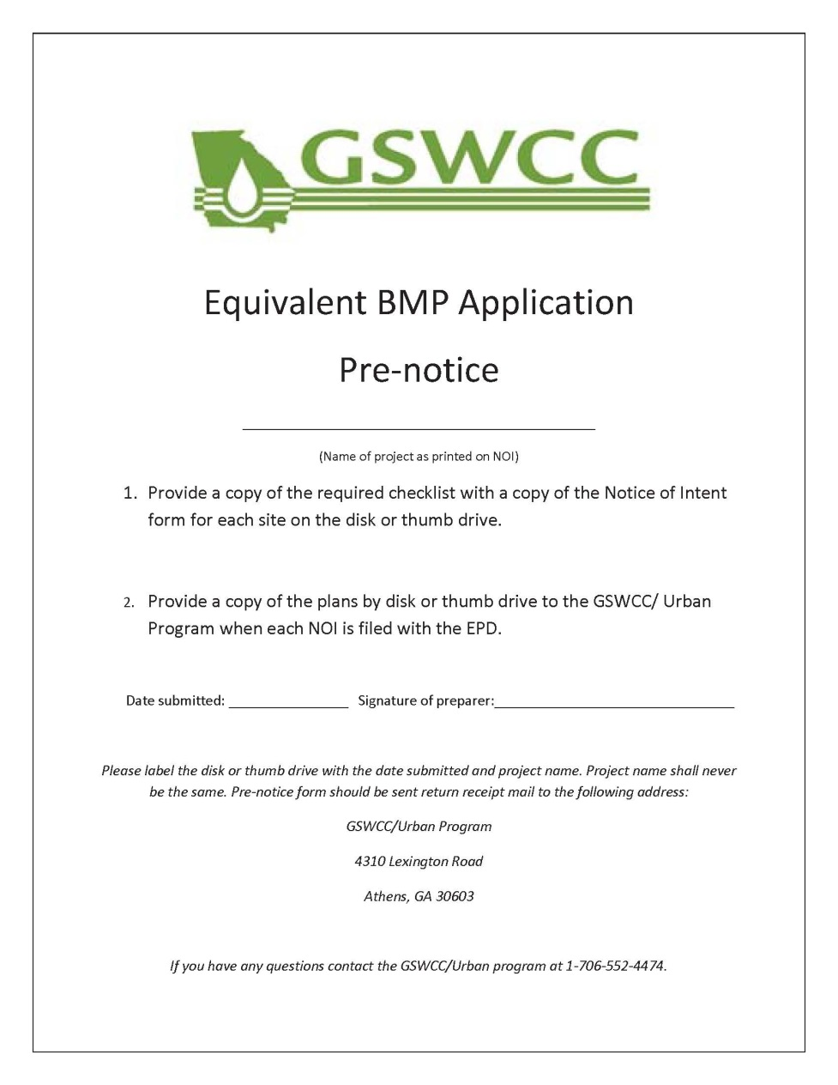
Checklist Item #42
45
Use of alternative BMP for application to the Equivalent BMP List.
Please refer to Appendix A-2 of the Manual for Erosion & Sediment Control in Georgia 2016 Edition.

Slide 46
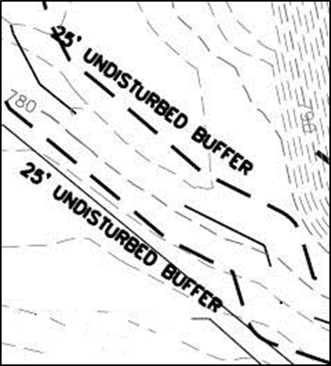
Checklist Item #43
46
Delineation of the applicable 25-foot or 50-foot undisturbed buffers adjacent to state waters and any additional buffers required by the Local Issuing Authority. Clearly note and delineate areas of impact.
The State Law of Georgia mandates these minimum undisturbed buffers, but the Local Issuing Authority are allowed to require more stringent buffers of state waters. The minimum undisturbed buffers required by the state and all other buffers of state waters required by the issuing authority must be delineated. Any undisturbed buffer area that is impacted by the project site must be noted on the Plan.

Slide 47
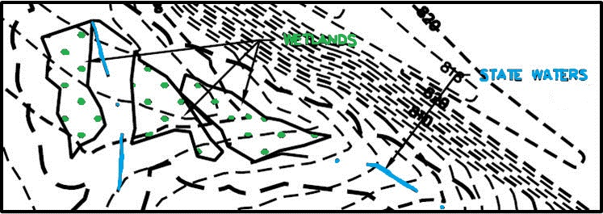
Checklist Item #44
47
Delineation of on-site wetlands and all state waters located on and within 200 feet of the project site.
ALL STATE WATERS LOCATED ON AND WITHIN 200 FEET OF THE PROJECT SITE MUST BE DELINEATED ON ALL PHASES OF THE PLAN.
When a project is located in a jurisdiction with a certified Local Issuing Authority and the LIA must make a determination of State waters that are not delineated on the Plan, the Plan review could be delayed for beyond the full forty-five day review time allowed to the LIA, or the full thirty-five day review time allowed to the District if the District is reviewing the Plan. For all projects in a jurisdiction where there is no certified Local Issuing Authority regulating that project, EPD is responsible for State waters determinations and there is no time limits for reviewing the Plan.
ALL WETLANDS LOCATED WITHIN THE PROJECT SITE ONLY MUST BE DELINEATED.
If the Local Issuing Authority requires an undisturbed buffer of wetlands, delineate required buffer.

Slide 48
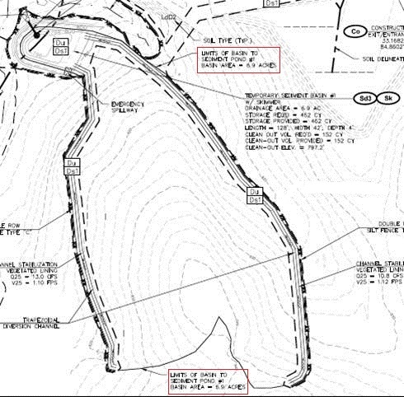
Checklist Item #45
48
Delineation and acreage of contributing drainage basins on the project site.
All existing drainage basins on the project site and their acreage must be delineated on the existing conditions and/or on the initial phase of the Plan. As the basins are altered or new ones created during intermediate and final phases, the new basins and their acreage must be delineated throughout each phase of the Plan.

Slide 49
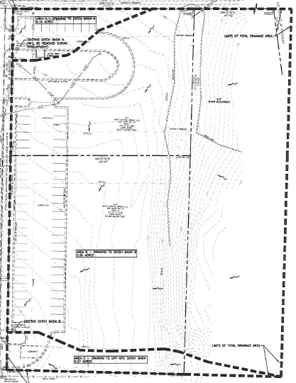
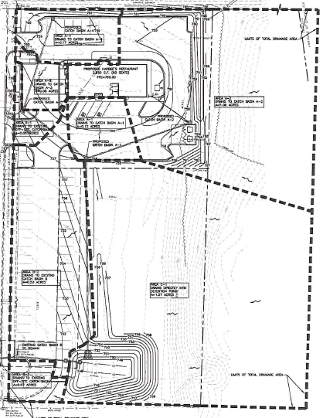
Checklist Item #46
49
Provide hydrology study and maps of drainage basins for both pre and post developed conditions.
Hydrology study and drainage maps should be separate from the Plan. Maps should include each individual basin draining to, through and from the project site, with each one delineated, labeled and showing its total acreage.
PRE-DEVELOPED
POST-DEVELOPED

Slide 50

Checklist Item #47
50
An estimate of the runoff coefficient or peak discharge flow of the site prior to and after construction activities are completed.
The Plan must provide both pre and post construction estimates of the runoff coefficient or peak discharge flow for the site. This can be in the form of a hydrologic study so long as that study is made a part of the Plan and accompanies the Plan. A complete hydrologic study is not required element of the Plan, only the pre and post construction estimates of the run-off coefficient or peak discharge flow for the site.

Slide 51
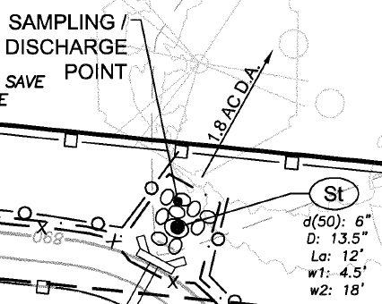
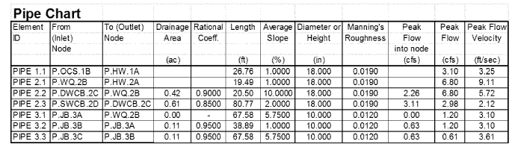
Checklist Item #48
51
Storm-drain pipe and weir velocities with appropriate outlet protection to accommodate discharges without erosion. Identify/Delineate all storm water discharge points.
The storm-drain pipe and weir velocities must show the flow characteristics of the pipe at full flow including pipe diameter, flow rate (cfs), velocity (fps), and tailwater conditions. This information should be shown in a chart on the storm-drain profile sheet, ES&PC intermediate phase sheet or on the ES&PC detail sheet that shows outlet protection. The dimensions of the apron must include length (La), width at the headwall (W1), down-stream width (W2), average stone diameter (d50), and stone depth (D) designed in accordance with Figures 6-34.1 and 6-34.2 in the Manual. These should be shown in a chart on ES&PC intermediate and/or final phase sheet or ES&PC detail sheet with outlet protection. Velocity dissipation devices shall be placed at all discharge locations and along the length of any outfall channel for the purpose of providing a non-erosive velocity flow from the structure to a water course so that the natural physical and biological functions and characteristics are maintained and protected.

Slide 52
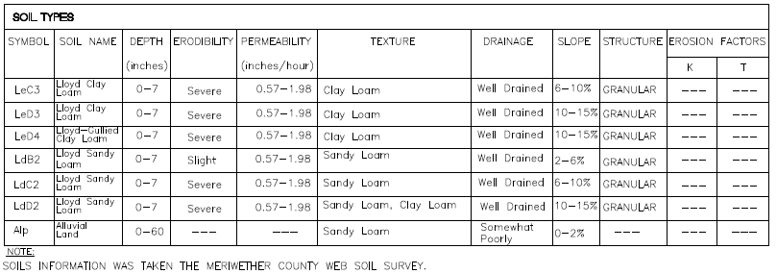
Checklist Item #49
52
Soil series for the project site and their delineation.
Soil series delineations are required for the Plan review and can be found on the NRCS website. The highest level of soil survey required for the project site, such as a level three or level four survey for projects that will be using septic systems, must be delineated on the Plan. The soil series delineation should be shown on the existing site Plan or the initial phase Plan. A chart listing the soils located on the project should be shown on the sheet with their delineation.

Slide 53
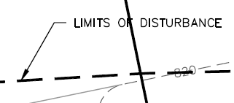
Checklist Item #50
53
The limits of disturbance for each phase of construction.
The limits of disturbance for the initial phase should delineate only the area required to be disturbed for the installation of perimeter control and initial sediment storage. The intermediate phase should delineate the entire area to be disturbed for that phase, such as grading, drainage, utilities installed, etc. The final phase should delineate any additional areas to be disturbed such as individual lots, etc.

Slide 54
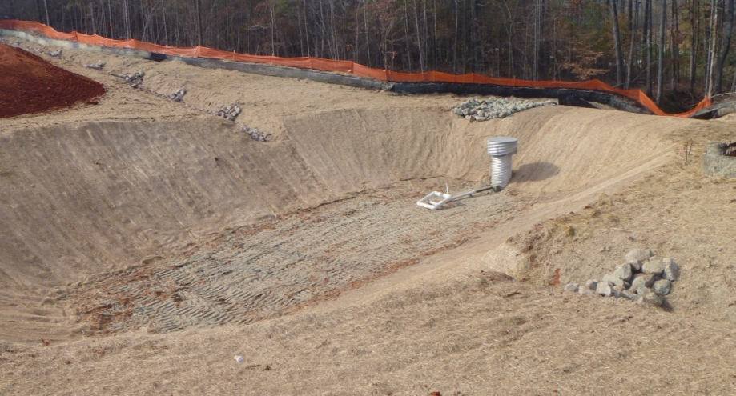
Checklist Item #51
54
Provide a minimum of 67 cubic yards of sediment storage per acre drained using a temporary sediment basin, retrofitted detention pond, and/or excavated inlet sediment traps for each common drainage location. Sediment storage volume must be in place prior to and during all land disturbance activities until final stabilization of the site has been achieved. A written justification explaining the decision to use equivalent controls when a sediment basin is not provided. A written justification as to why 67 cubic yards of storage is not attainable must also be given. Worksheets from the Manual must be included for structural BMPs and all calculations used by the design professional to obtain the required sediment storage when using equivalent controls. When discharging from sediment basins and impoundments, permittees are required to utilize outlet structures that withdraw water from the surface, unless infeasible. If outlet structures that withdraw water from the surface are not feasible, a written justification explaining this decision must be included in the Plan.

Slide 55
Checklist Item #51 (Cont.)
55
For each common drainage location, a temporary (or permanent) sediment basin (Sd3, Sd4, Rt, or excavated Sd2) providing at least 67 cubic yards of storage per acre drained, or equivalent control measures, shall be provided until final stabilization of the site. The 67 cubic yards of storage per acre does not apply to flows from off-site areas and flows from on-site areas that are either undisturbed or have undergone final stabilization where such flows are diverted around both the disturbed area the sediment basin. Sediment basins may not be appropriate for some common drainage locations and a written justification explaining the decision not to use sediment basins must be included in the Plan. Worksheets from the Manual must be completed and shown on the Plan or attached to the Plan for each temporary sediment basin designed for the project. All cross sections and details required per the Manual for Sd3’s must be shown on the ES&PC detail section of the Plan. Completed worksheets from the Manual must be shown on the Plan for each retrofit and excavated inlet sediment trap. When the design professional chooses to use equivalent controls the calculations used to obtain the required 67 cubic yards per acre drained must be included in the Plan. If outlet structures that withdraw water from the surface are not feasible, a written justification explaining this decision must be included in the Plan.

Slide 56
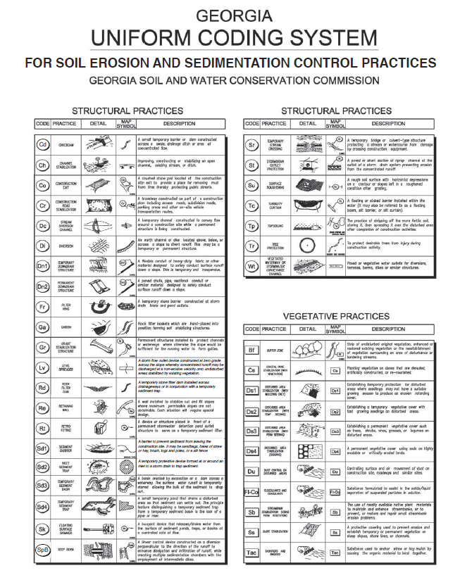
Checklist Item #52
56
Location of Best Management Practices that are consistent with and no less stringent than the Manual for Erosion and Sediment Control in Georgia. Use uniform coding symbols from the Manual, Chapter 6, with legend.
BMPs for all phases of the Plan must be consistent with and no less stringent than the Manual and shown using uniform coding symbols from the Manual. The uniform coding symbols legend from the Manual must be included and may be shown on detail sheet or any of the ES&PC Plan sheets.

Slide 57
Checklist Item #53
57
Provide detailed drawings for all structural practices. Specifications must, at a minimum, meet the guidelines set forth in the Manual for Erosion and Sediment Control in Georgia.
The erosion and sediment control detail sheet must show a detailed drawing for each structural BMP shown on the Plan. All BMPs and details shown must, at a minimum, meet the guidelines given in the Manual. Note that a worksheet is provided in the Manual for most structural BMPs that must be included on the ES&PC Plan or detail sheet.

Slide 58
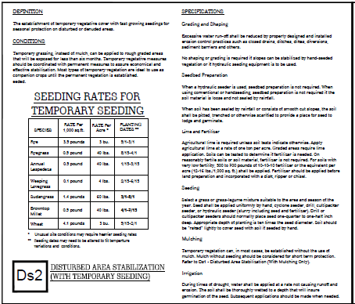
Checklist Item #54
58
Provide vegetative plan, noting all temporary and permanent vegetative practices. Include species, planting dates, and seeding, fertilizer, lime, and mulching rates. Vegetative plan shall be site specific for appropriate time of year that seeding will take place and for the appropriate geographic region of Georgia.
Must be shown on ES&PC Plan, on the ES&PC detail sheet or under ES&PC notes.

Slide 59

Questions?
GSWCC
Urban Program
4310 Lexington Road
Athens, GA 30605
(706) 552-4474

